Slide 1
Chapter 10: Designing Organizational Structure

Slide 2
Defining Organizational Structure
Organizational Structure
  The formal arrangement of jobs within an organization.
Organizational Design
  A process involving decisions about six key elements:
    Work specialization
    Departmentalization
    Chain of command
    Span of control
    Centralization and decentralization
    Formalization

Slide 3
Exhibit 10–1 Purposes of Organizing
Divides work to be done into specific jobs and departments.
Assigns tasks and responsibilities associated with individual jobs.
Coordinates diverse organizational tasks.
Clusters jobs into units.
Establishes relationships among individuals, groups, and departments.
Establishes formal lines of authority.
Allocates and deploys organizational resources.

Slide 4
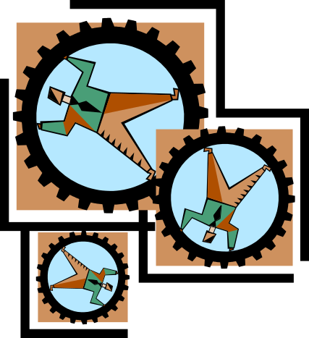
Organizational Structure
Work Specialization
  The degree to which tasks in the organization are divided into separate jobs with each step completed by a different person.
  Overspecialization can result in human diseconomies from boredom, fatigue, stress, poor quality, increased absenteeism, and higher turnover.

Slide 5
Departmentalization by Type
Functional
  Grouping jobs by functions performed
Product
  Grouping jobs by product line
Geographical
  Grouping jobs on the basis of territory or geography
Process
  Grouping jobs on the basis of product or customer flow
Customer
  Grouping jobs by type of customer and needs

Slide 6
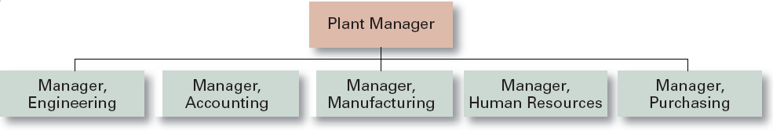
Exhibit 10–3 Functional Departmentalization
Advantages
  Efficiencies from putting together similar specialties and people with common skills, knowledge, and orientations
  Coordination within functional area
  In-depth specialization
Disadvantages
  Poor communication across functional areas
  Limited view of organizational goals

Slide 7
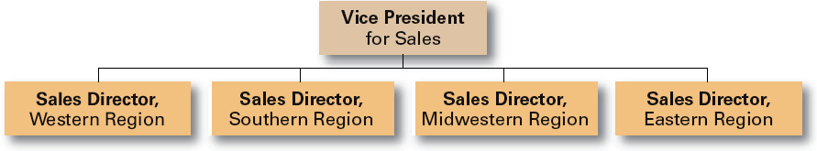
Exhibit 10–3 (cont’d) Geographical Departmentalization
Advantages
  More effective and efficient handling of specific regional issues that arise
  Serve needs of unique geographic markets better
Disadvantages
  Duplication of functions
  Can feel isolated from other organizational areas

Slide 8
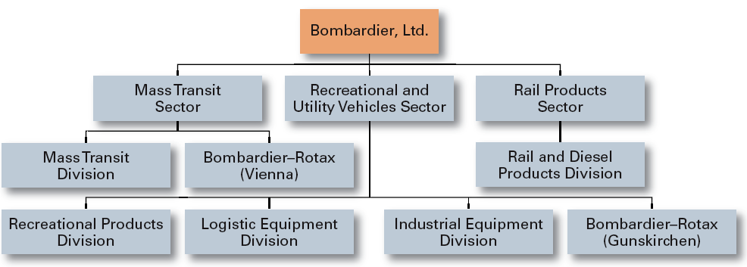
Exhibit 10–3 (cont’d) Product Departmentalization
+ Allows specialization in particular products and services
+ Managers can become experts in their industry
+ Closer to customers
– Duplication of functions
– Limited view of organizational goals

Slide 9
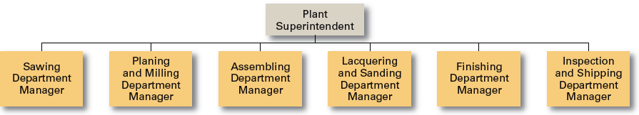
Exhibit 10–3 (cont’d) Process Departmentalization
+ More efficient flow of work activities
– Can only be used with certain types of products

Slide 10
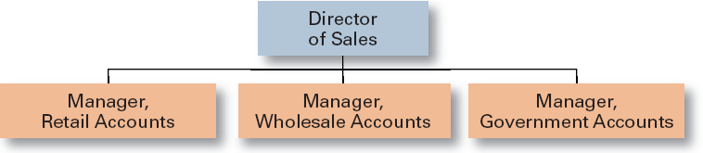
Exhibit 10–3 (cont’d) Customer Departmentalization
+ Customers’ needs and problems can be met by specialists
- Duplication of functions
- Limited view of organizational goals

Slide 11

Organization Structure (cont’d)
Chain of Command
  The continuous line of authority that extends from upper levels of an organization to the lowest levels of the organization and clarifies who reports to who.

Slide 12
Organization Structure (cont’d)
Span of Control
  The number of employees who can be effectively and efficiently supervised by a manager.
  Width of span is affected by:
    Skills and abilities of the manager
    Employee characteristics
    Characteristics of the work being done
    Similarity of tasks
    Complexity of tasks
    Physical proximity of subordinates
    Standardization of tasks

Slide 13
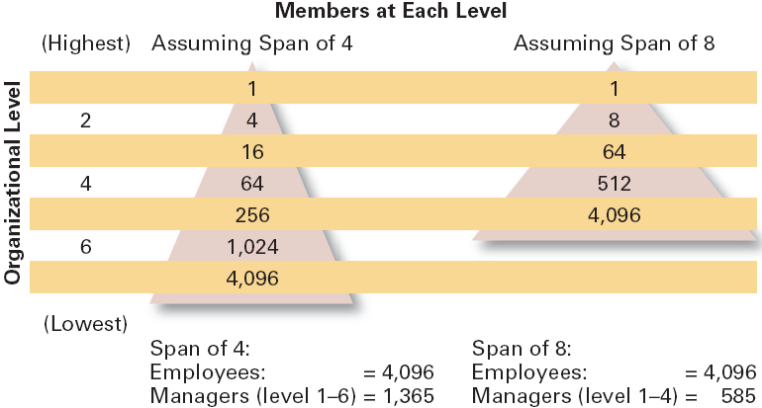
Exhibit 10–3 Contrasting Spans of Control

Slide 14
Organization Structure (cont’d)
Centralization
  The degree to which decision-making is concentrated at a single point in the organizations.
    Organizations in which top managers make all the decisions and lower-level employees simply carry out those orders.
Decentralization
  Organizations in which decision-making is pushed down to the managers who are closest to the action.
Employee Empowerment
  Increasing the decision-making authority (power) of employees.

Slide 15
Organization Structure (cont’d)
Formalization
  The degree to which jobs within the organization are standardized and the extent to which employee behavior is guided by rules and procedures.
    Highly formalized jobs offer little discretion over what is to be done.
    Low formalization means fewer constraints on how employees do their work.

Slide 16
Organizational Design Decisions
Mechanistic Organization
  A rigid and tightly controlled structure
    High specialization
    Rigid departmentalization
    Narrow spans of control
    High formalization
    Limited information network (downward)
    Low decision participation
Organic Organization
  Highly flexible and adaptable structure
    Non-standardized jobs
    Fluid team-based structure
    Little direct supervision
    Minimal formal rules
    Open communication network
    Empowered employees

